Slide 1
ILLINOIS LSW APPLICATION
INSTRUCTIONS AND INFORMATION

Slide 2
LSW Required Materials
The LSW only requires you to fill out 3 forms and submit a $50 application fee. The forms are:
Application for Licensure.
▶ 4 pages, complete on your own.
Health Care Workers Charged with or Convicted of Criminal Acts (CCA form)
▶ 1 page, complete on your own.
Certification of Education (ED) Form. The Loyola School of Social Work (Student
Affairs) fills out the second half of this form, entitled "School Official“.

Slide 3
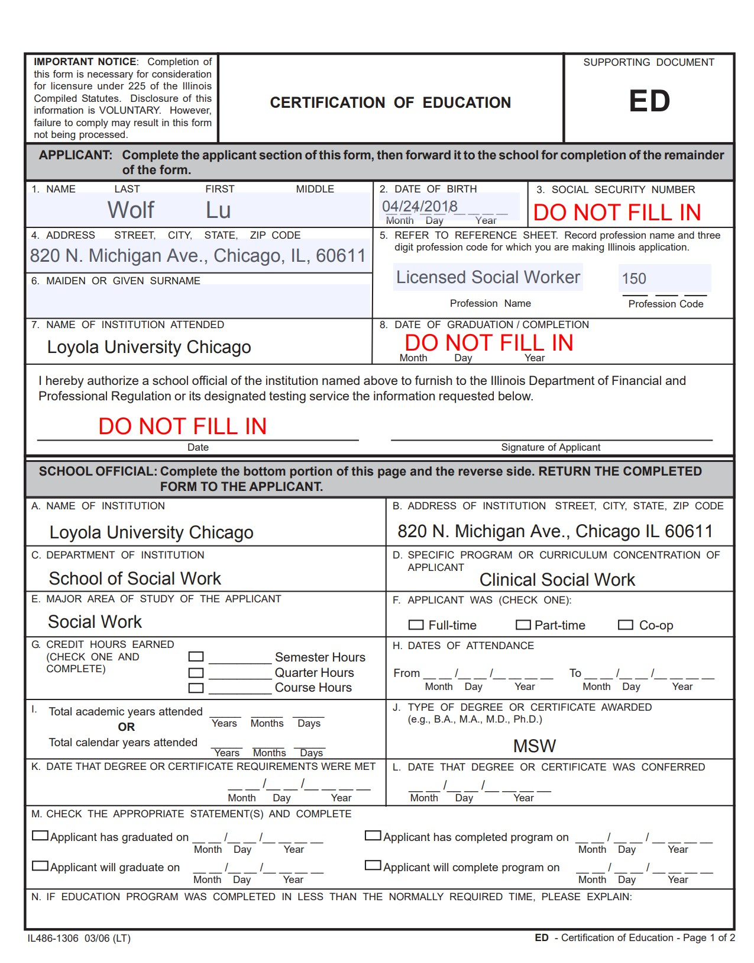
ED form, front
Scan and send via email to Tiffaney Young at ssw-licensure@luc.edu

Slide 4
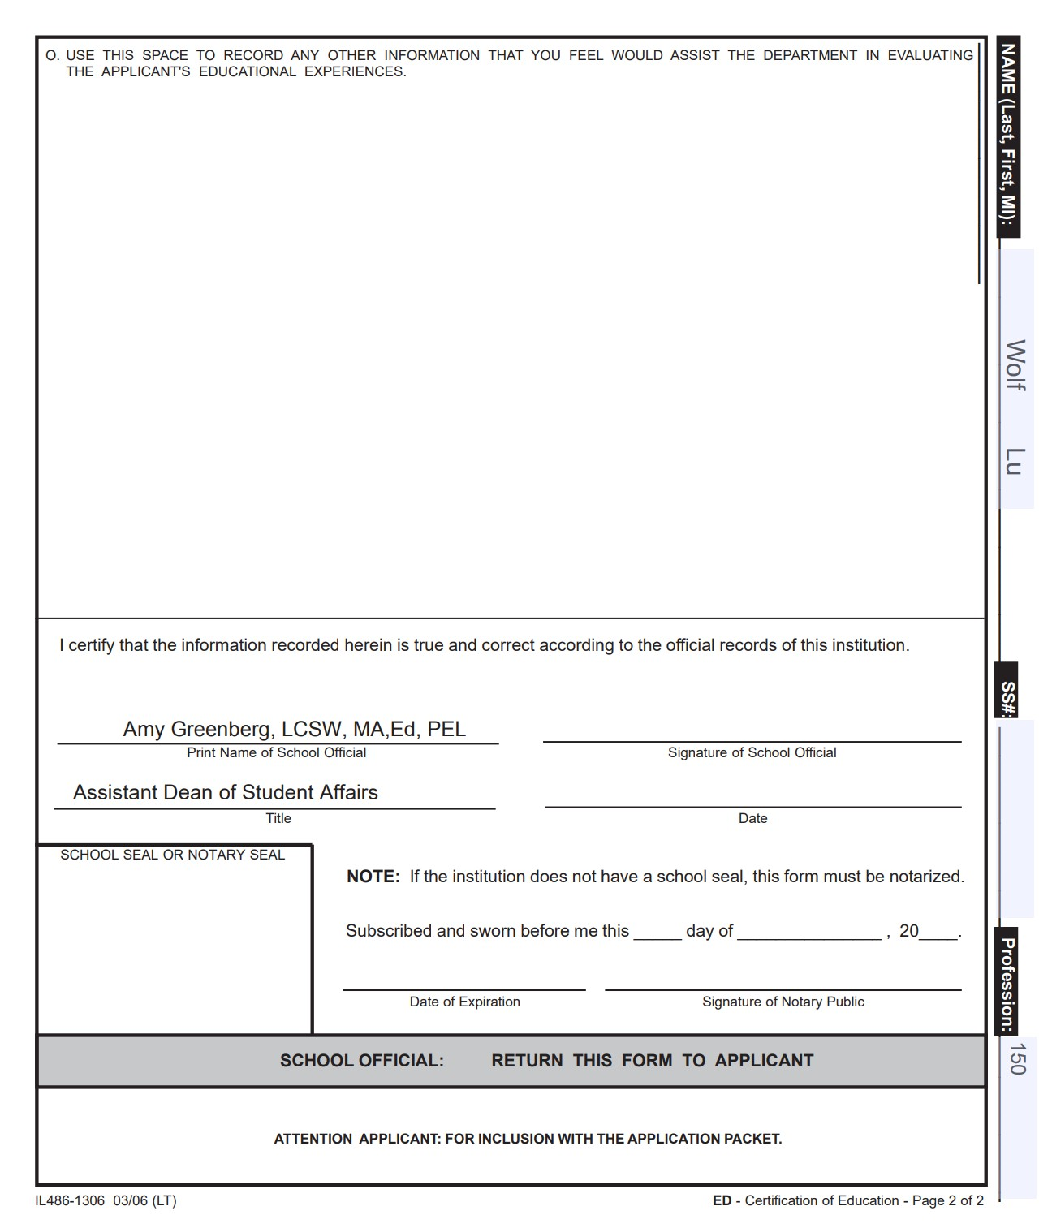
ED form, back
Scan and send via email to Tiffaney Young at ssw-licensure@luc.edu

Slide 5
▶ The School of Social Work will process your licensure form within 30- 45 days after your degree has been conferred.
▶ Approximate timeframe is July for spring graduates, September for summer graduates and February for fall graduates.
▶ All materials must be completed in BLACK INK ONLY.
▶ There are no refunds on application fees so be sure to submit all paperwork correctly.

Slide 6
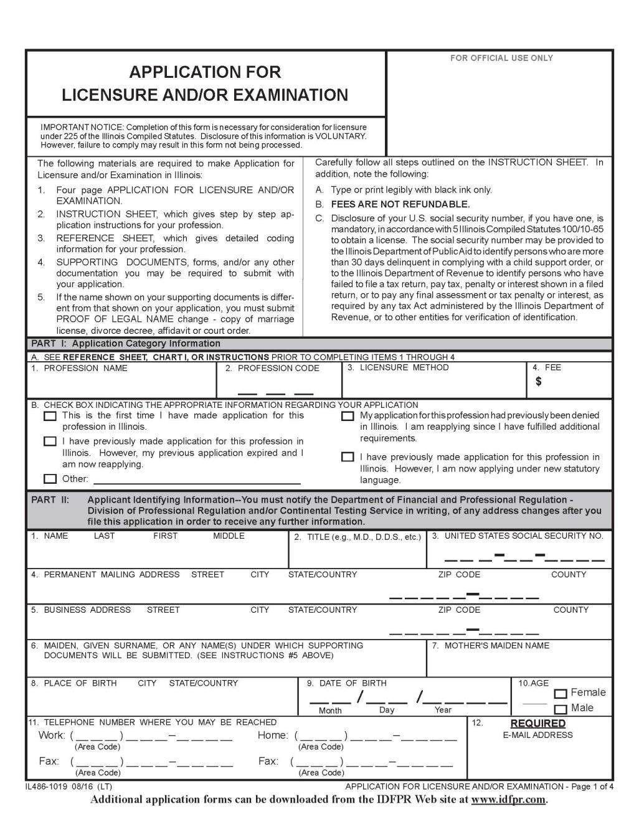
Application for Licensure

Slide 7
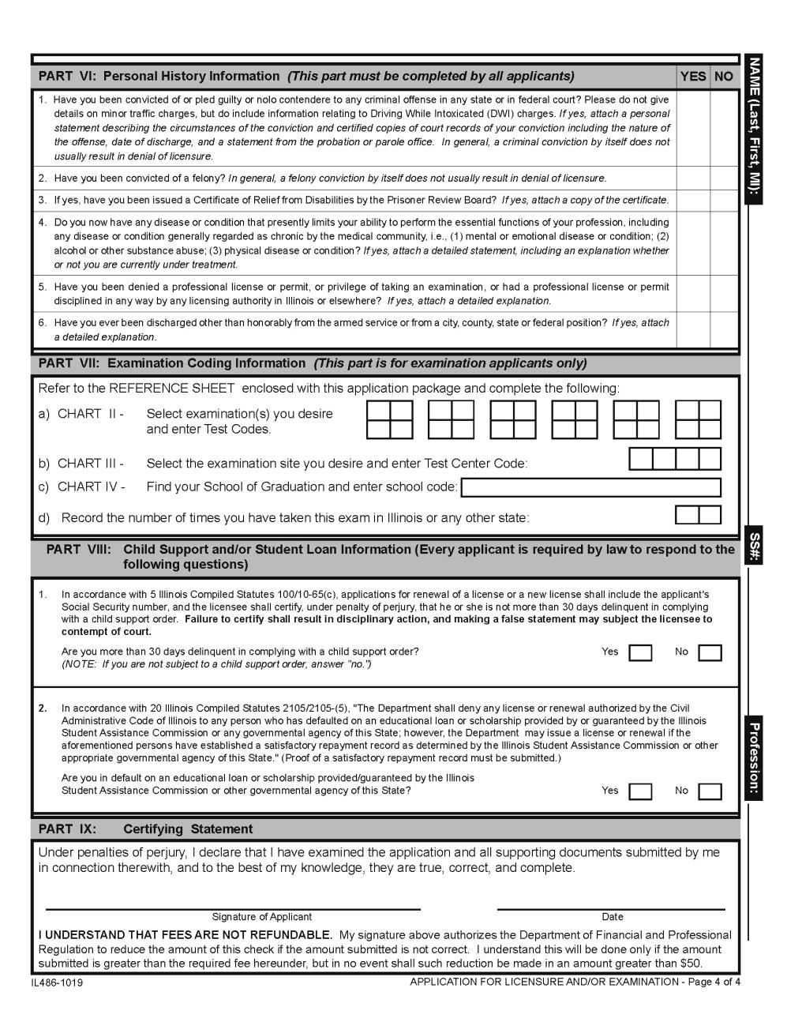
Form
Write N/A for Part 7 on the 4th page of the application.

Slide 8
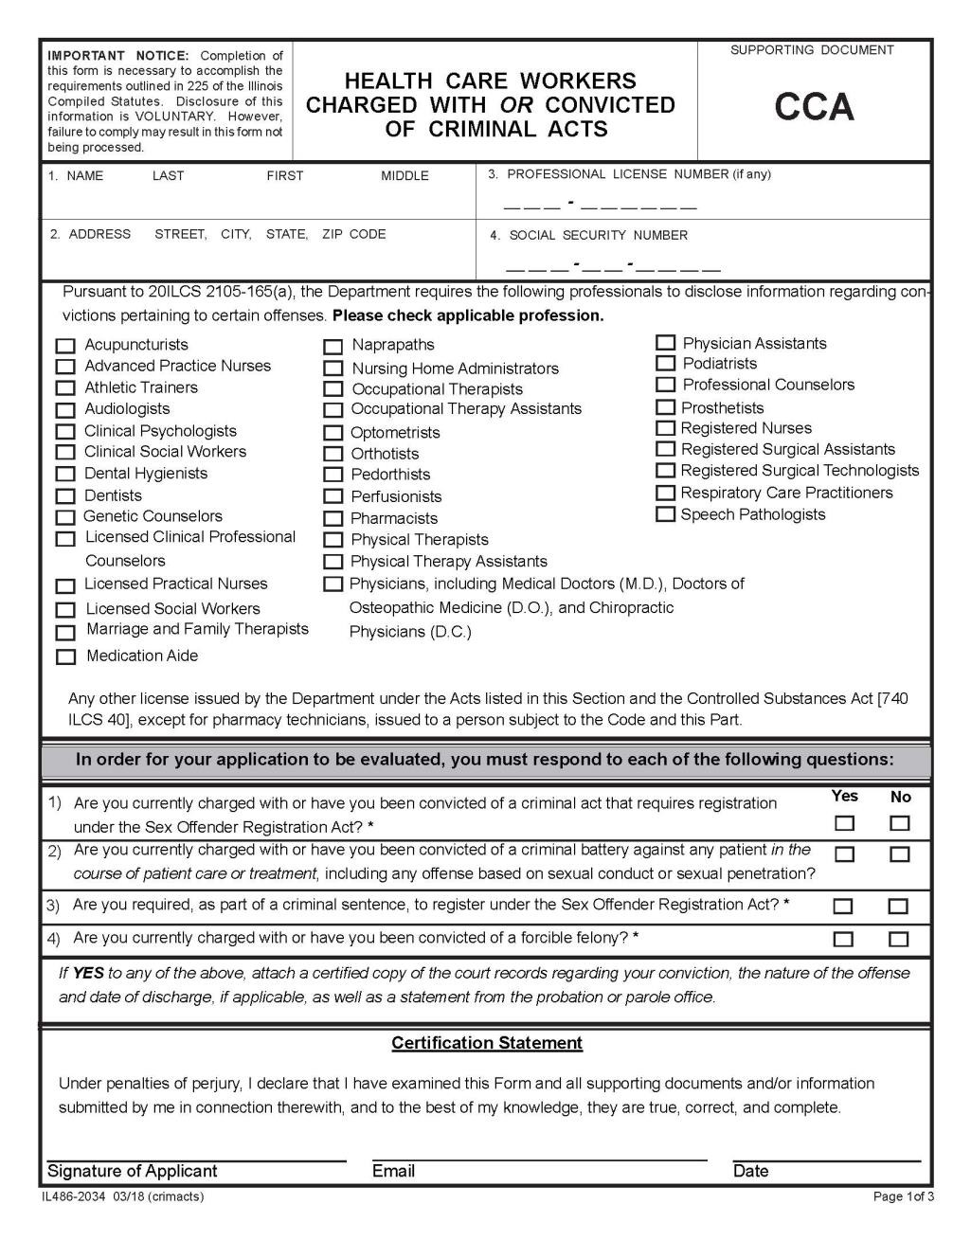
CCA form
▶ Make sure to complete this form in its entirety.

Slide 9
▶ Once you have received the completed Certification of Education form in the mail- OPEN THE ENVELOPE!
▶ Please add your social security number and the current date.
▶ Compile all your materials.
▶ Application, CCA form and Certification of Education form- mail them to the Illinois Department of Professional Regulation (IDFPR). The address is included in your packet as well as in the memo that you will receive in the mail.

Slide 10
LUC Contact Information
▶ Questions about your degree conferral? Contact your academic advisor:
▶ Assistant Director of Academic Advising
▶ Verónica Arreola, varreola@luc.edu
▶ Advanced Standing and Online Bilingual students
▶ Academic Advisor
▶ Jodi Goode, jgoode@luc.edu
▶ 5-year MSW students
▶ Academic Advisor
▶ Ruth Tekeste, rtekeste@luc.edu
▶ Full-time/Part-Time MSW students
▶ Questions about licensure or your Certificate of Education form? Contact Tiffaney Young at ssw-licensure@luc.edu
▶ Questions about your PEL? Contact Amy Greenberg at agreenberg2@luc.edu
▶ Visit: www.luc.edu/socialwork/student-support/licensure/illinois-licensure-lsw for more information

